Slide 1
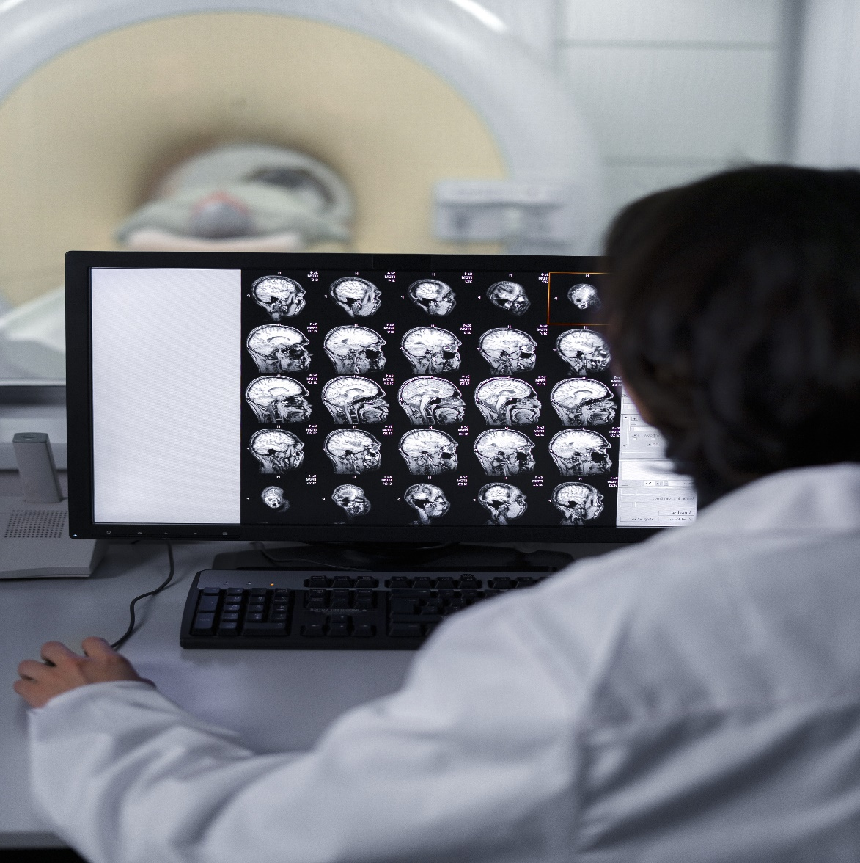
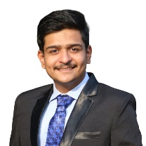


CT Image Denoising
PID_1544
Photo
(Author 1)
Photo
(Author 2)
Photo
(Author 3)
Jeet Nakrani
Mayank Kathane
Shubham Vishwakarma
College Name - Mukesh Patel School of Technology Management and Engineering
Location - Mumbai
College Mentor Name – Manishkumar Tiwari

Slide 2
Challenge Statement
Understanding the Problem
In medical imaging, particularly brain CT scans, image quality is often compromised by two prevalent types of noise:
Poisson Noise:
Originates from the statistical nature of photon detection during image acquisition.
Periodic Noise:
Caused by interference from electronic and mechanical components in the CT scanner.
Challenge Requirement
The objective is to develop a software tool capable of:
Reading and displaying CT brain scans in DICOM format.
Designing an algorithm that reduces Poisson and periodic noise effectively.
Enhancing image clarity while preserving essential diagnostic information, leading to more accurate diagnoses.

Slide 3
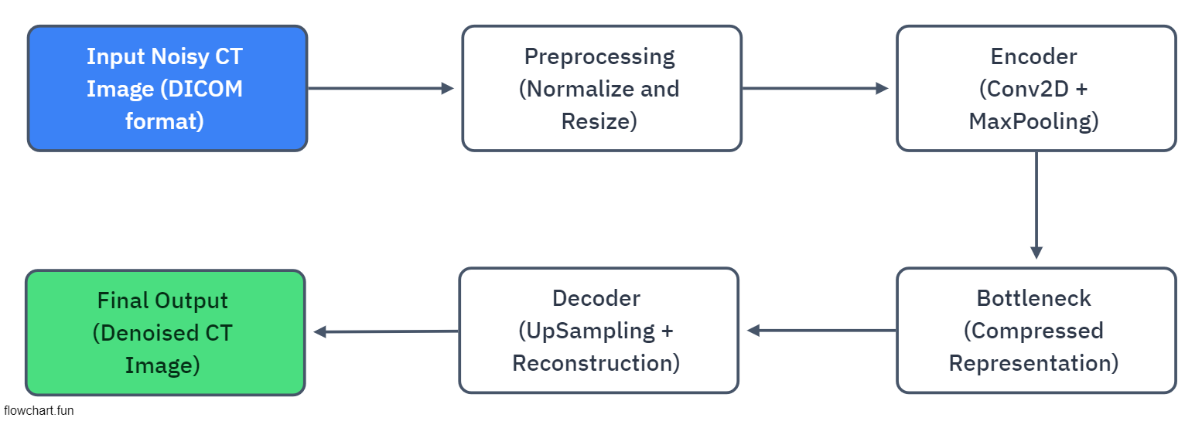
Concept / Solution
The proposed solution uses deep learning-based Denoising Autoencoders to remove noise from CT brain images.
The tool will take in noisy CT images as input and produce clean, denoised output for better clarity.
It involves a deep convolutional architecture, including an encoder-decoder structure, optimized with mean squared error loss.

Slide 4
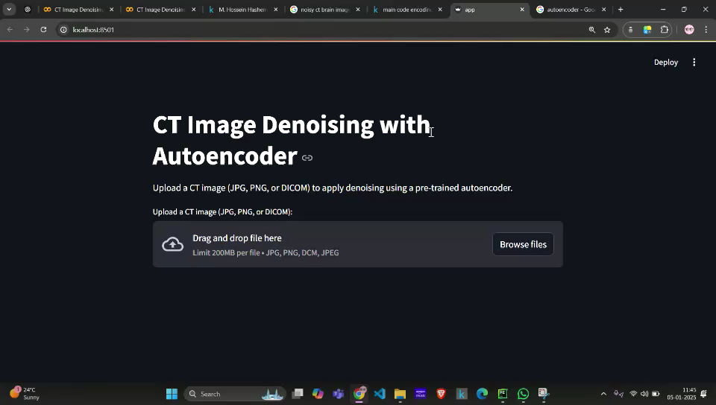
Current Status of POC
AutoEncoder Model successfully Implemented
Deployed on our local system via Streamlit
Also able to display SNR values as output with the denoised image.

Slide 5
Further Plans and Testing process
Interactive User Interface
Downloadable results
Multiple files upload in one go.
Deploy on live server and test performance

Slide 6
Queries to the mentors
Modules in software model??
How to scale and in what terms??
How to make a winnable solution??
Any other models to use??

Slide 7

Thank You!!!

